Slide 1

ECE 419/619
Electric Machines and Drives
Dc Machines

Slide 2
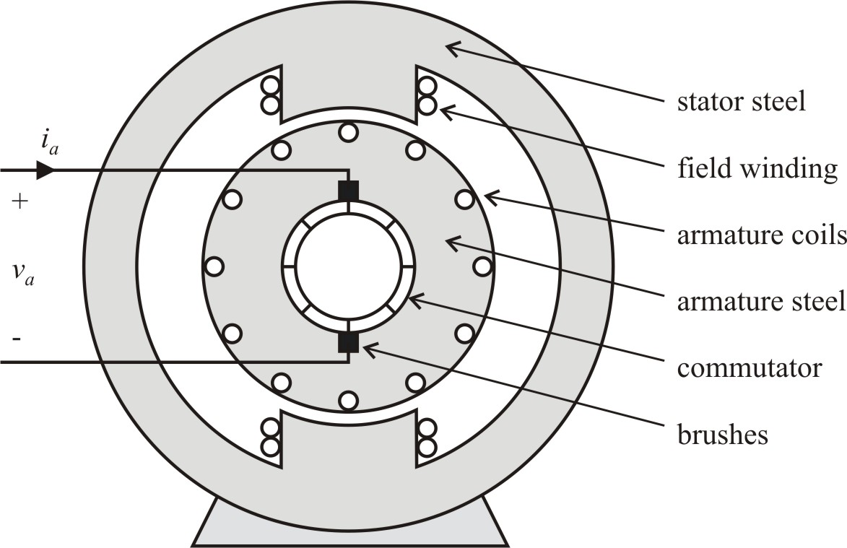
DC Machines (Chapter 2)
Electrical terminals:
Field v_{f}, i_{f} - establishes stator poles
Armature v_{a}, i_{a} - establishes rotor poles at 90º to
stator poles regardless of rotor position

Slide 3
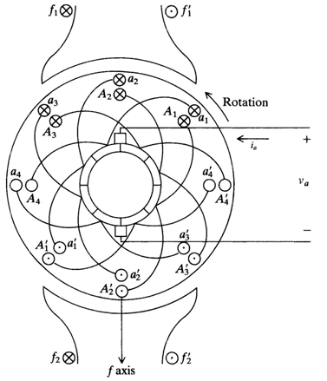
Dc Machine
Cross-Section θ_{r} = 45º
N
N
S
S

Slide 4
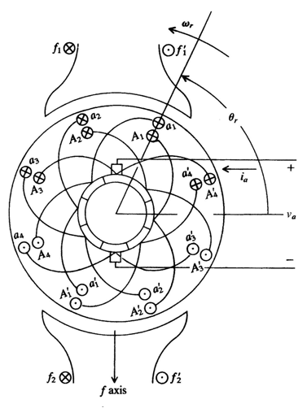
Dc Machine Cross-Section
θ_{r} = 67.5º
N
N
S
S

Slide 5
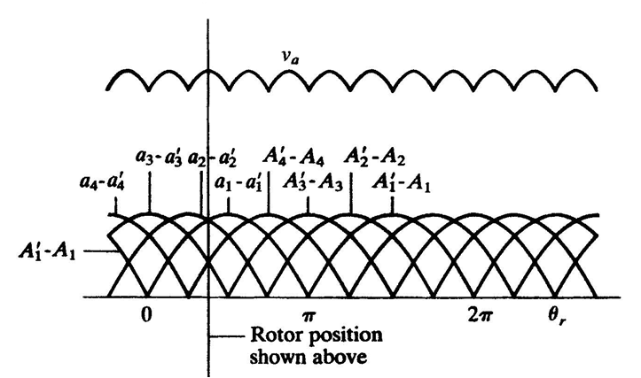
Induced Armature Voltage (Back-EMF)

Slide 6
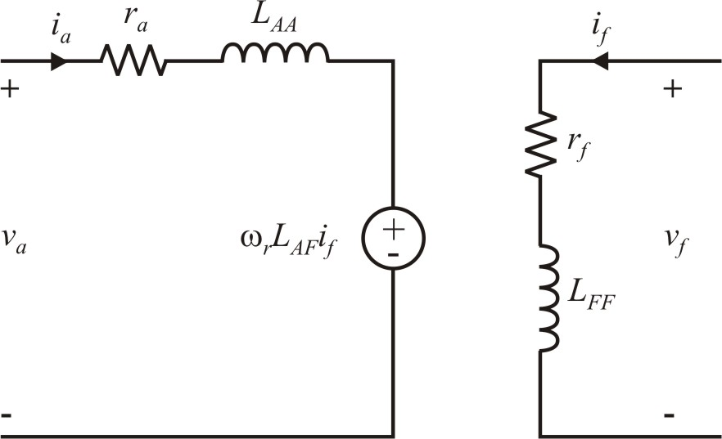
DC Motor Electrical Model
armature equation
field equation
v_{a} = armature voltage (V)
i_{a} = armature current (A)
r_{a} = armature resistance (Ω)
L_{AA} = armature inductance (H)
L_{AF} = armature to field inductance (H)
v_{f} = field voltage (V)
i_{f} = field current (A)
r_{f} = field resistance (Ω)
L_{FF} = field inductance (H)
dc motor torque

Slide 7
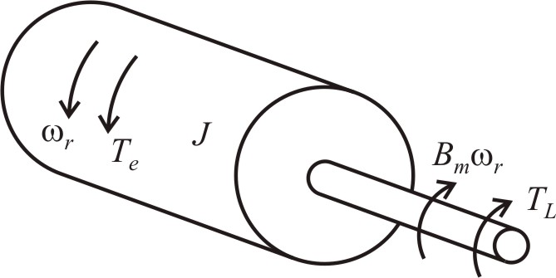
Mechanical Equations
also
T_{e} - electrical torque (N∙m)
T_{L} - load torque (N∙m)
ω_{r} - mechanical speed (rad/sec)
θ_{r} - mechanical rotor position (rad)
B_{m} - friction constant (Kg∙m²/sec)
J - total inertia (Kg∙m²)
Note: Model is same regardless
of number of poles

Slide 8
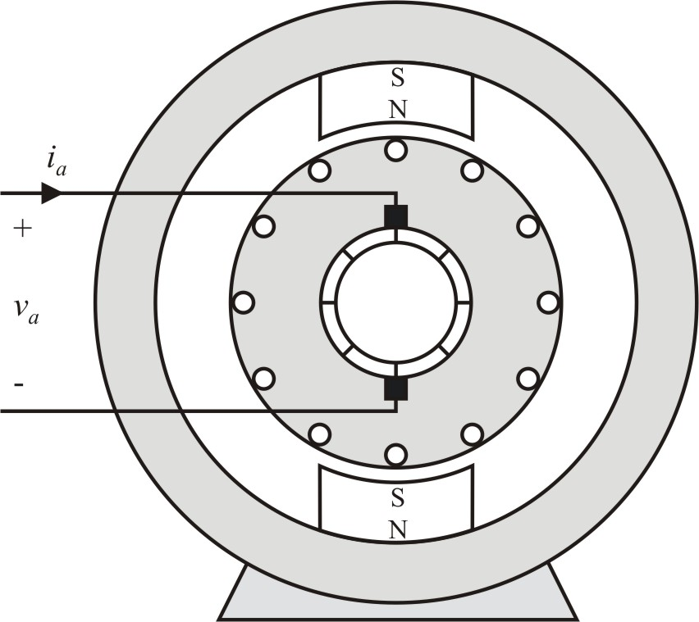
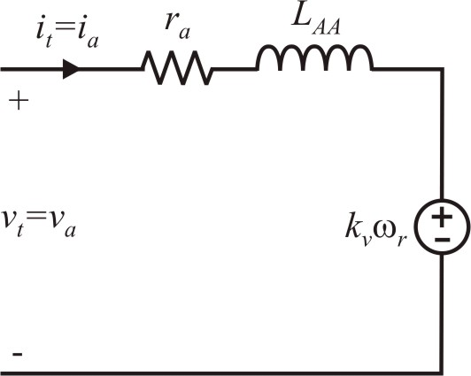
Permanent-Magnet DC Motor
Magnet has the effect of constant i_{f}
define k_{v} = L_{AF} i_{f}
k_{v} - back-emf constant or
torque constant (N∙m/A)=(V∙s)
steady-state with B_{m}=0

Slide 9
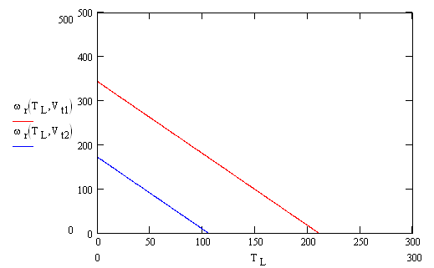
Permanent-Magnet Dc Motor Characteristic
V_{t} = V_{t1}
V_{t1} > V_{t2}
V_{t} = V_{t2}

Slide 10
Dc Machine Advantages
Simple Control
Low cost (for dc and single-phase ac applications)
Dc Machine Disadvantages
Maintenance (brush wear)
Electromagnetic radiation (brush/commutator)

Slide 11
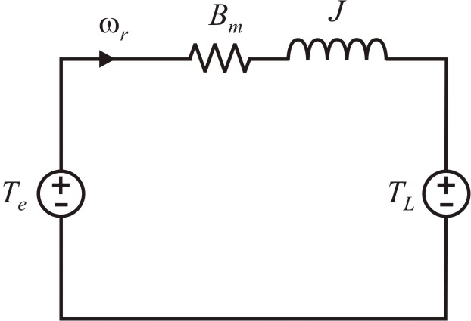
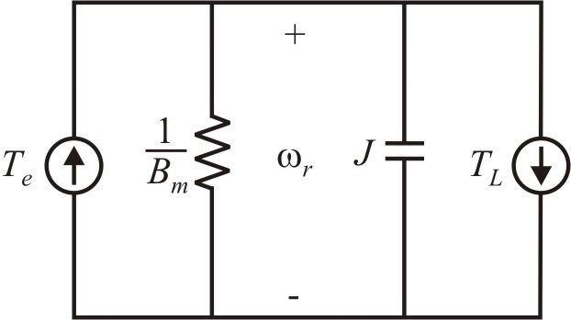
Electric Circuit Analogies
mechanical equation
torque-voltage analogy
torque-current analogy

Slide 12
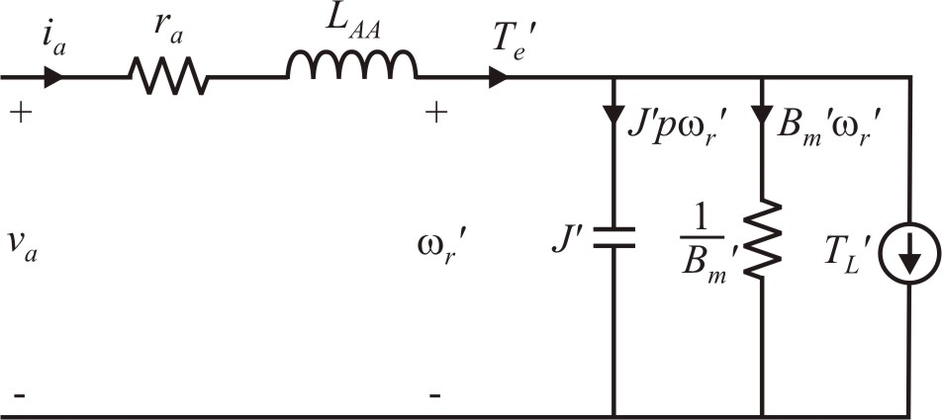
Permanent-Magnet DC Motor Modeling
define
electrical circuit compresst with the mechanical circuit

Slide 13
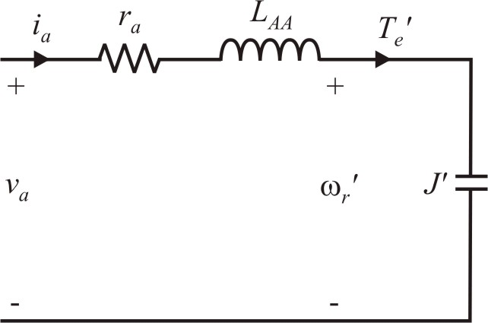
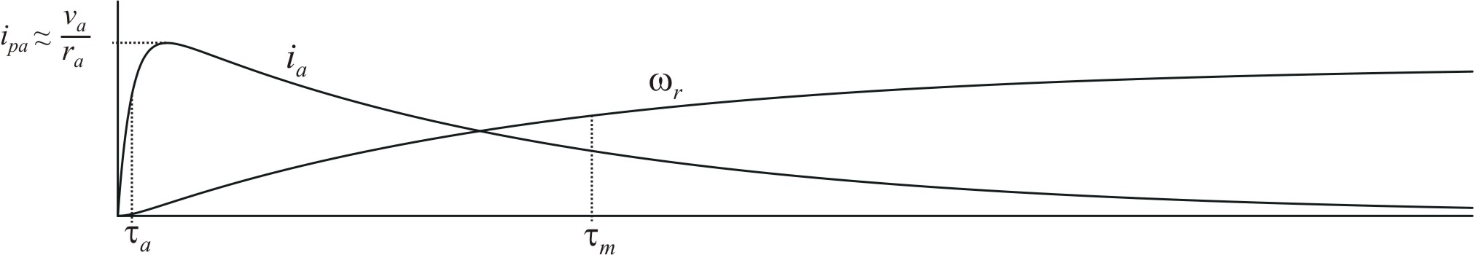
PMDC Motor Approximate Analysis
neglect friction (B_{m}=0), no-load T_{L}=0
note: steady-state
no-load speed
time constants
typically, τ_{m} >> τ_{a}
start-up waveforms

Slide 14
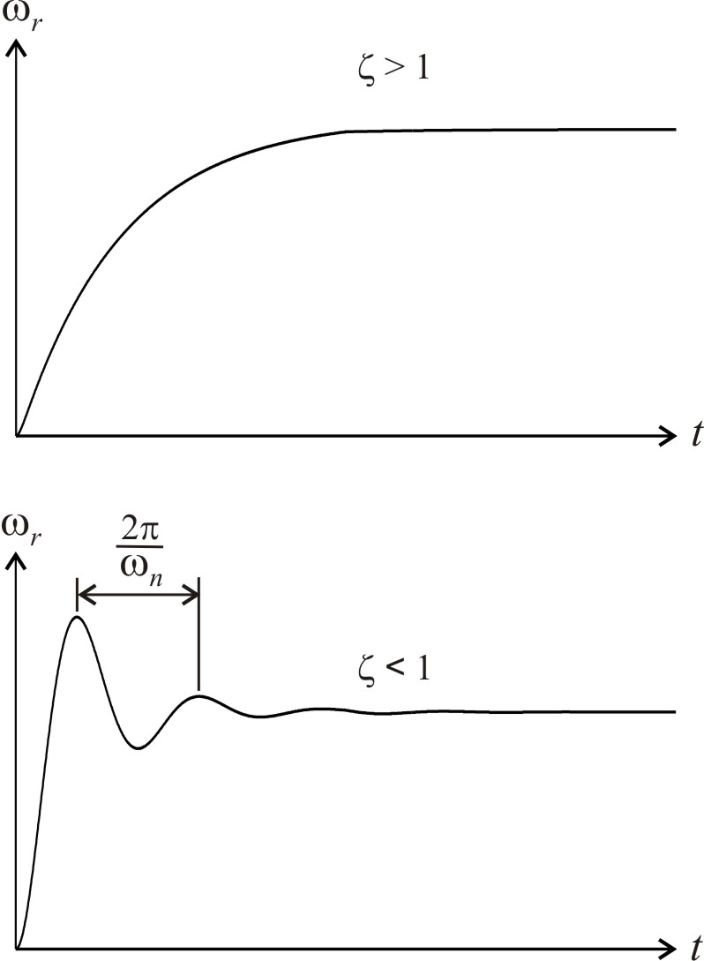
PMDC Transfer Function
Neglect friction, B_{m}=0. No-load, T_{L}=0.
start-up examples
Natural frequency
Damping ratio

Slide 15
PMDC Example Calculations

Slide 16
PMDC Calculations (Under-damped Case)

Slide 17
PMDC Calculations (Over-damped Case)

Slide 18
1. Circuit-Based Simulation
using PSIM 9.1

Slide 19
Circuit Simulation (Under-Damped)

Slide 20
Circuit Simulation (Over-Damped)

Slide 21
2. Block Diagram Simulation of Differential Equations
Write important equations in terms of the highest derivative
Integrator outputs are states
Avoid using blocks
All loops must contain integrators
using Simulink R2010b

Slide 22
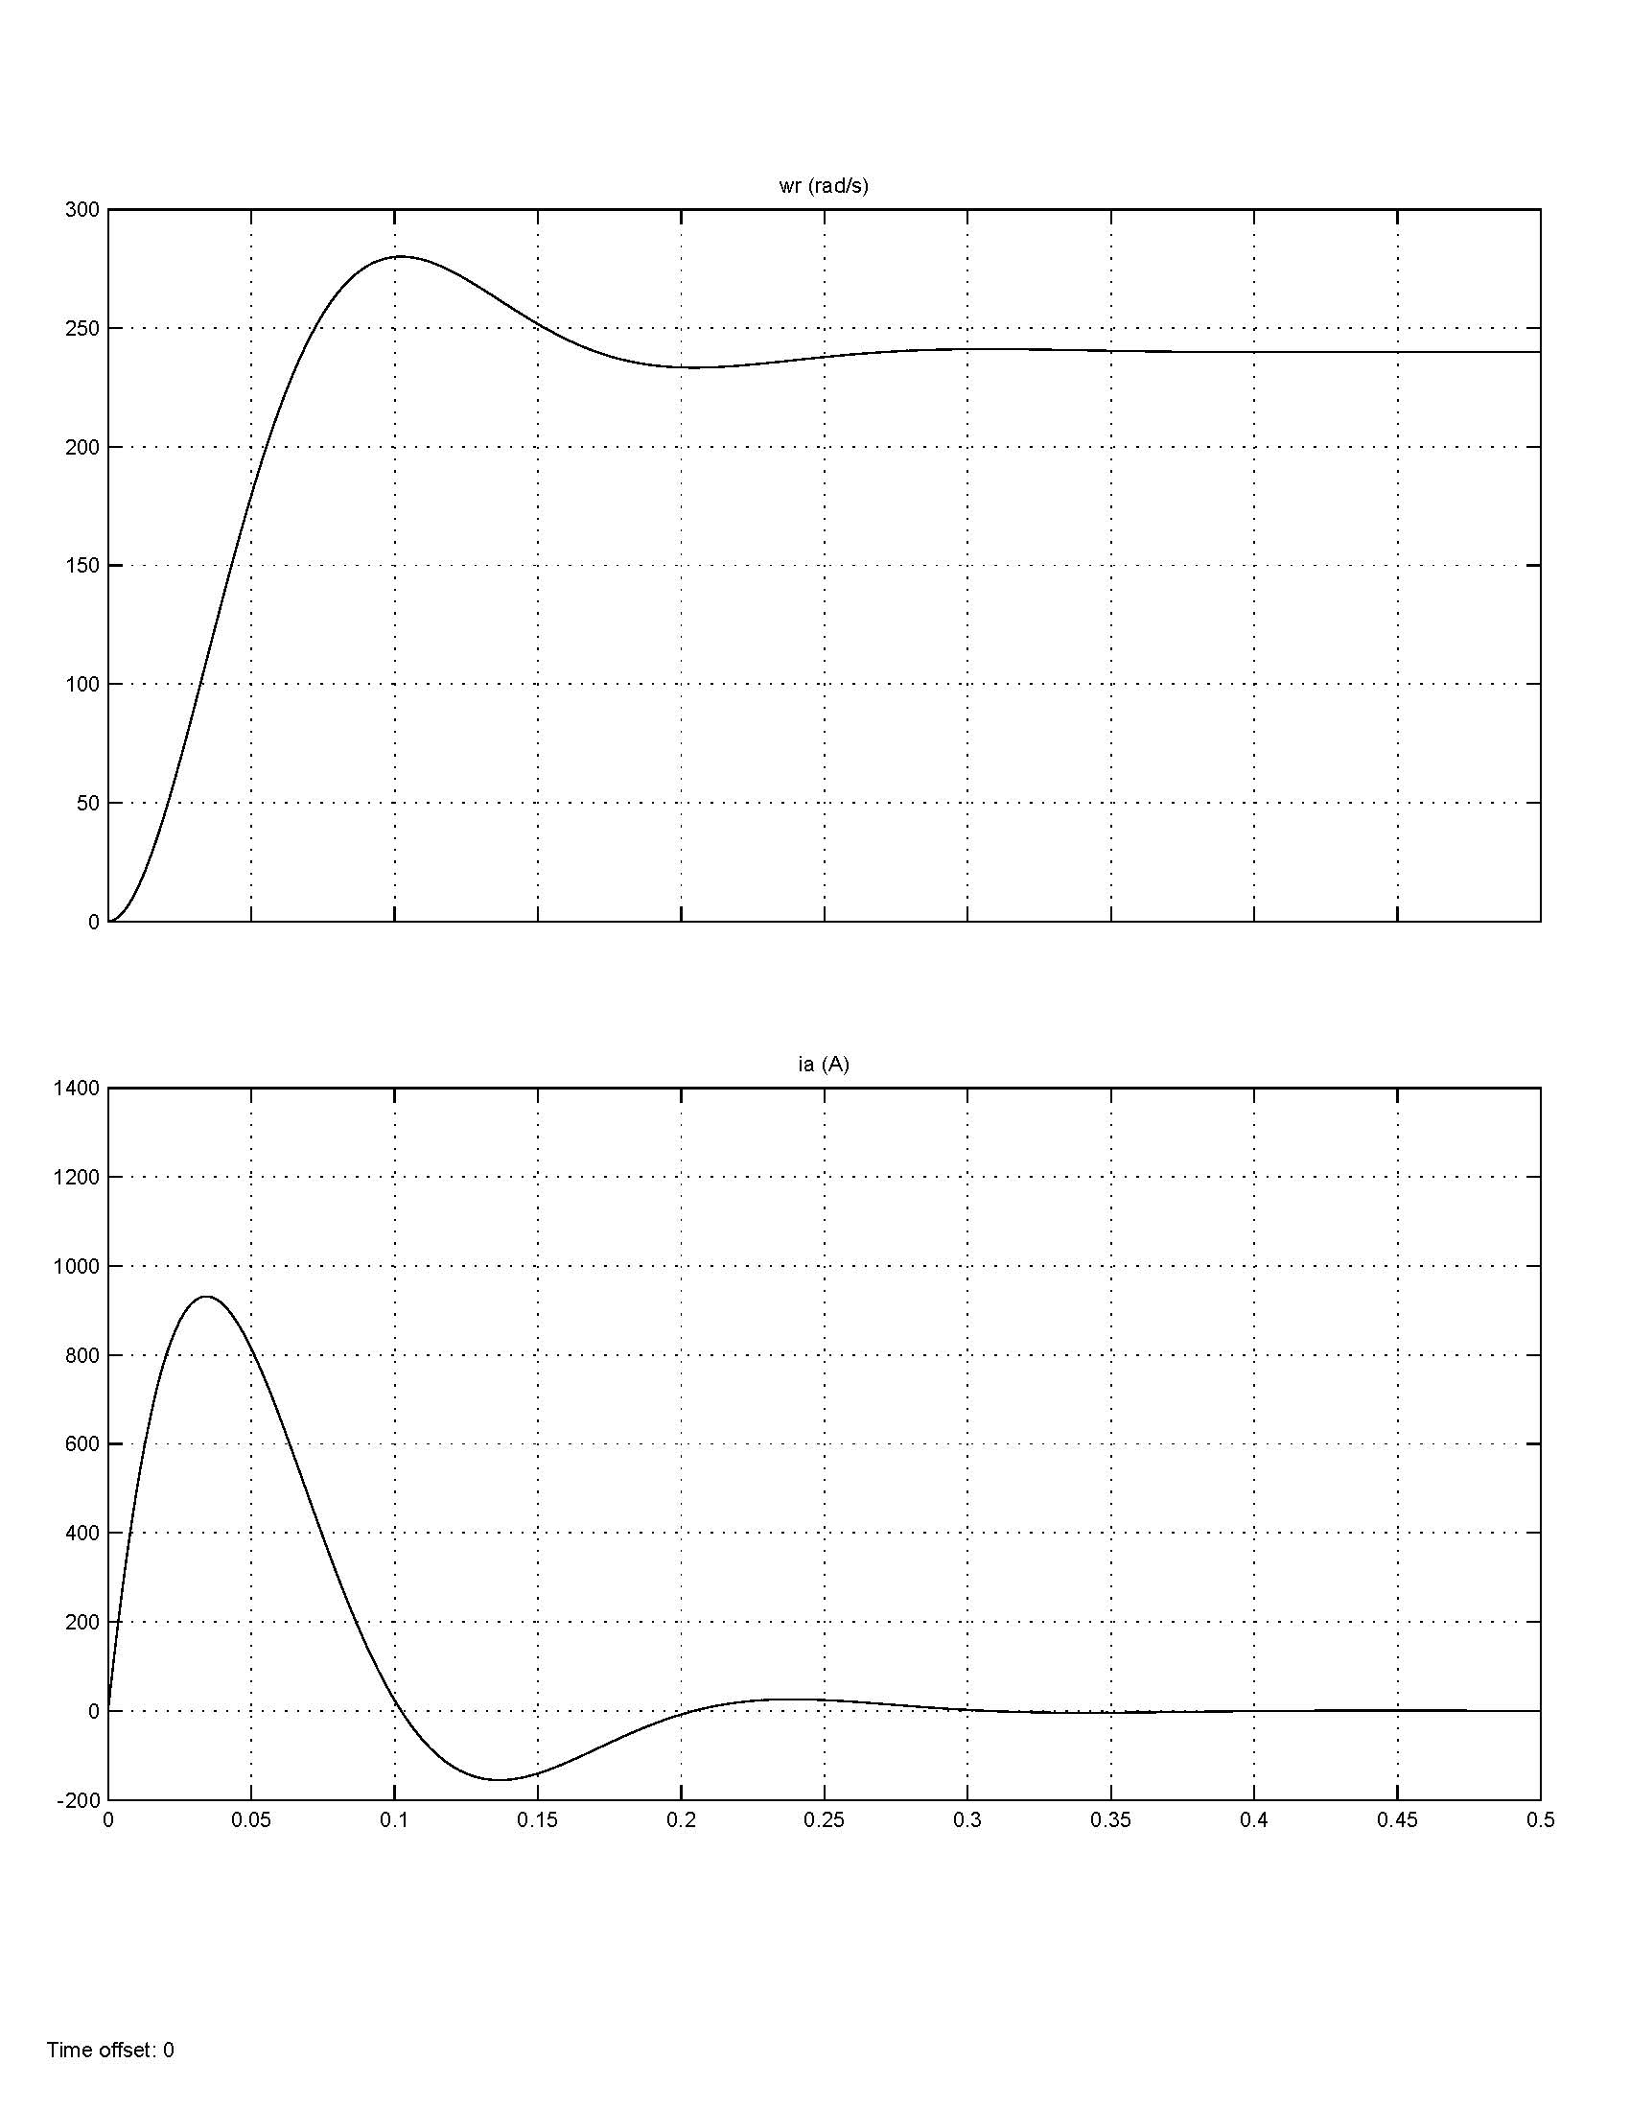
Block Diagram Simulation (Under-Damped)

Slide 23
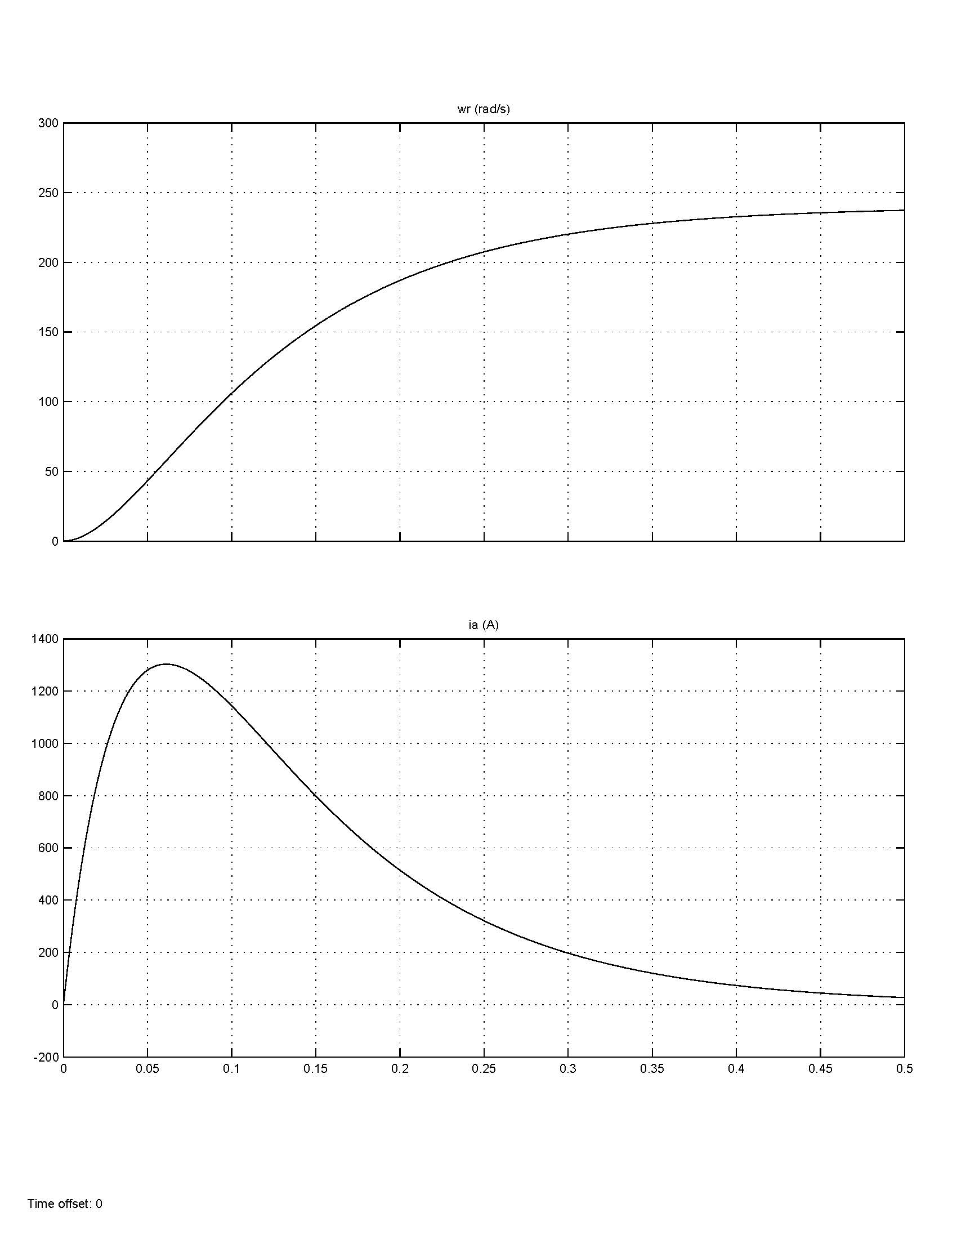
Block Diagram Simulation (Over-Damped)

Slide 24
3. Transfer Function Simulation
(Controller Canonical Form)
for the PMDC machine ω_{r}/v_{a} transfer function

Slide 25
Transfer Function Simulation
(Observer Canonical Form)

Slide 26
Higher Order Numerator Functions

Slide 27
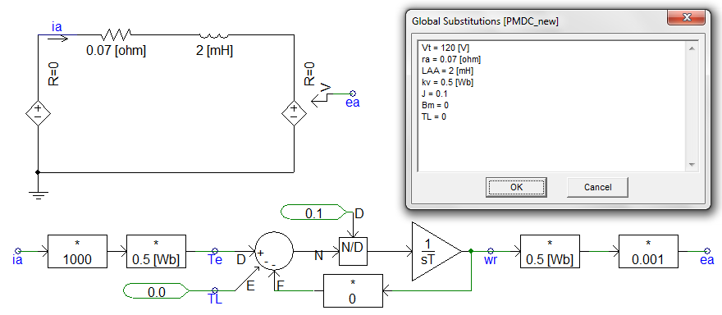
4. Mixed Circuit / Block Diagram Simulation
using PSCAD v4.2

Slide 28
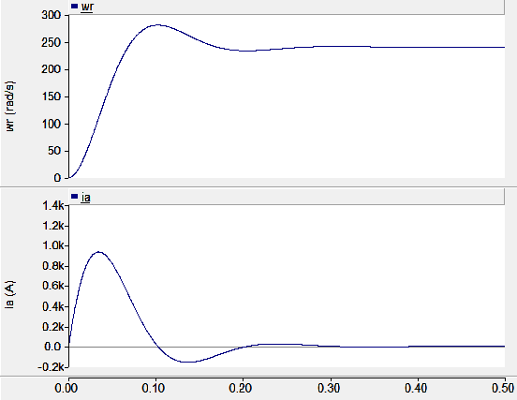
Mixed Circuit / Block Diagram Simulation
(Under-Damped Case)

Slide 29
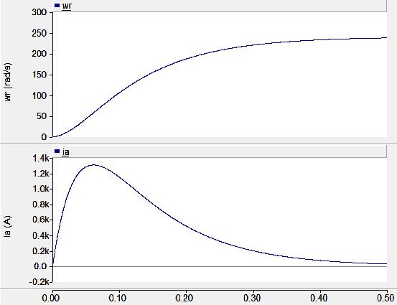
Mixed Circuit / Block Diagram Simulation
(Over-Damped Case)

Slide 30
5. Pre-Programmed Models
using Simulink R2010b
SimPowerSystems

Slide 31
Pre-Programmed Model Simulation
(Under-Damped)

Slide 32
Pre-Programmed Model Simulation
(Over-Damped)

Slide 33
Simulation Methods
1. Equivalent circuit form - Easy for building electrical circuits. Good for connection to motor drive simulation. Requires circuit analogy for mechanical system.
2. Block diagram form – Produces highly efficient simulation. Requires manual manipulation of equations.
3. Transfer function simulation - Direct simulation of transfer functions. Sometimes states are not representative of physical quantities.
4. Mixed circuit / block diagram form - Good for interfacing to drive simulations.
5. Pre-programmed model - Good for classical machines and power circuits (PSCAD, SimPowerSystems, etc.)

Slide 34
PMDC Motor Model
model equations
model inputs
model outputs
some types of load cases
Case 1: no-load
Case 2: fan load
Case 3: constant load

Slide 35
Case 1: No-Load
Machine equations in Laplace form →

Slide 36
No-Load Case, i_{a}/v_{a}

Slide 37
transfer function denominator
put in form

Slide 38
step input
partial fraction expansion
and inverse Laplace transform
for start-up,
equations 2D-29 and 2D-30 in book

Slide 39
Closed Form Equations (Under-Damped Case)

Slide 40
Closed Form Equations (Over-Damped Case)

Slide 41
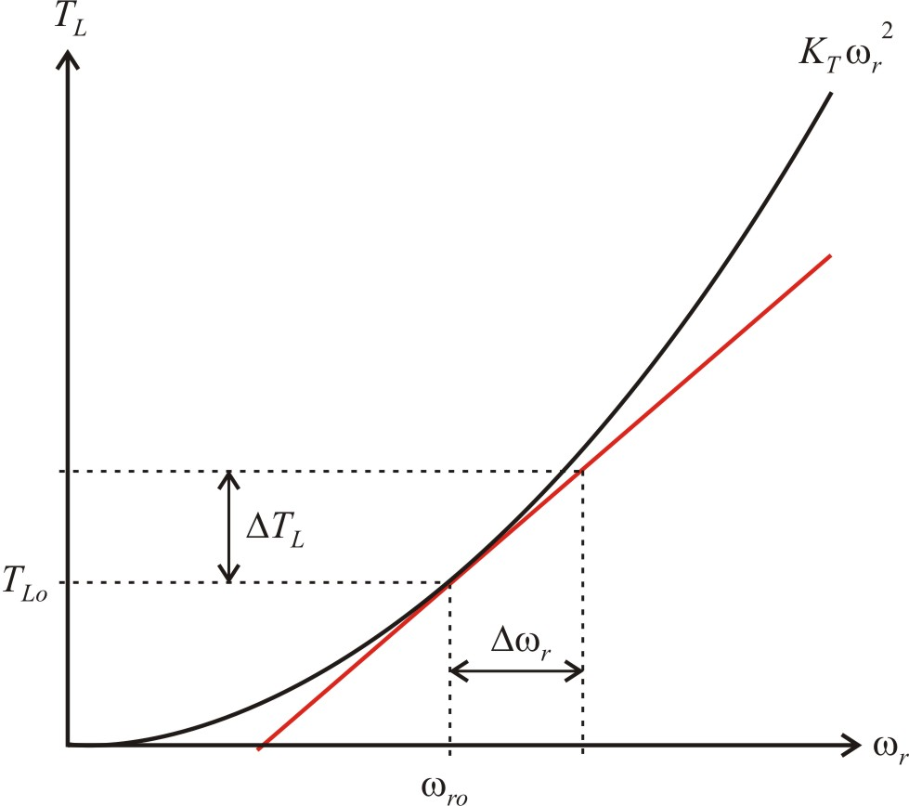
Case 2: Fan Load
Linearize about an operating point
works for small

Slide 42
Development of Linearized Equations
model variables
voltage equation
torque and mechanical equation
steady-state operating point
delta equations

Slide 43
Fan Load Transfer Function

Slide 44
Fan Load Example

Slide 45
Fan Load Example Constants

Slide 46
Fan Load Example Torque Characteristic

Slide 47
Case 3: Constant Load

Slide 48
Dc Machine Transfer Functions
For no-load, the closed form solution was found (as in the book example)
For fan and constant loads, a transfer function can be found from the linearized equations

